Slide 1
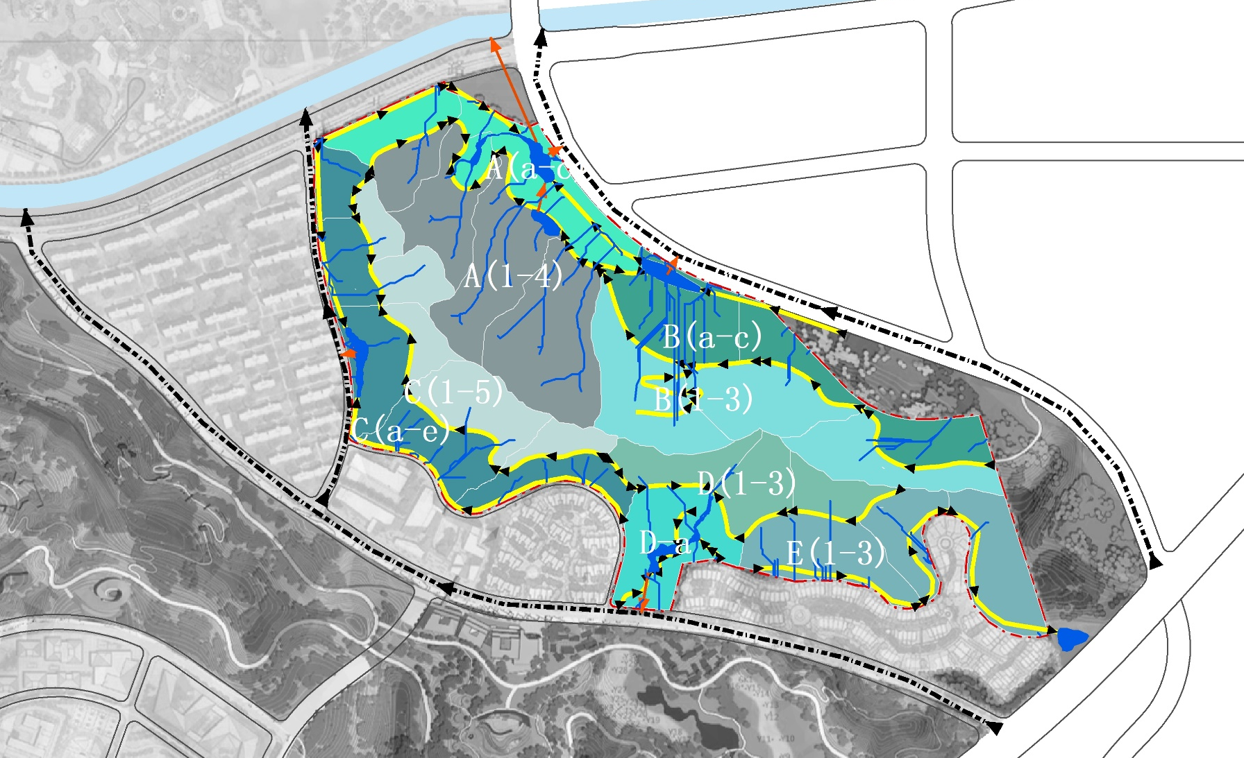

Slide 2
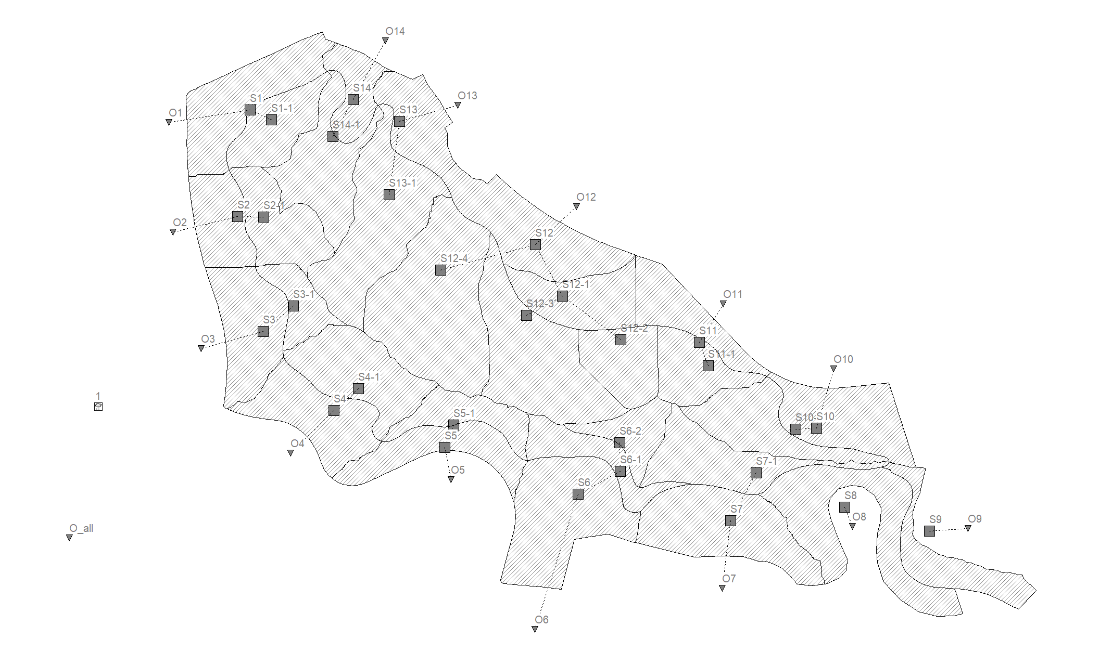

Slide 3
Scenario 01

Slide 4
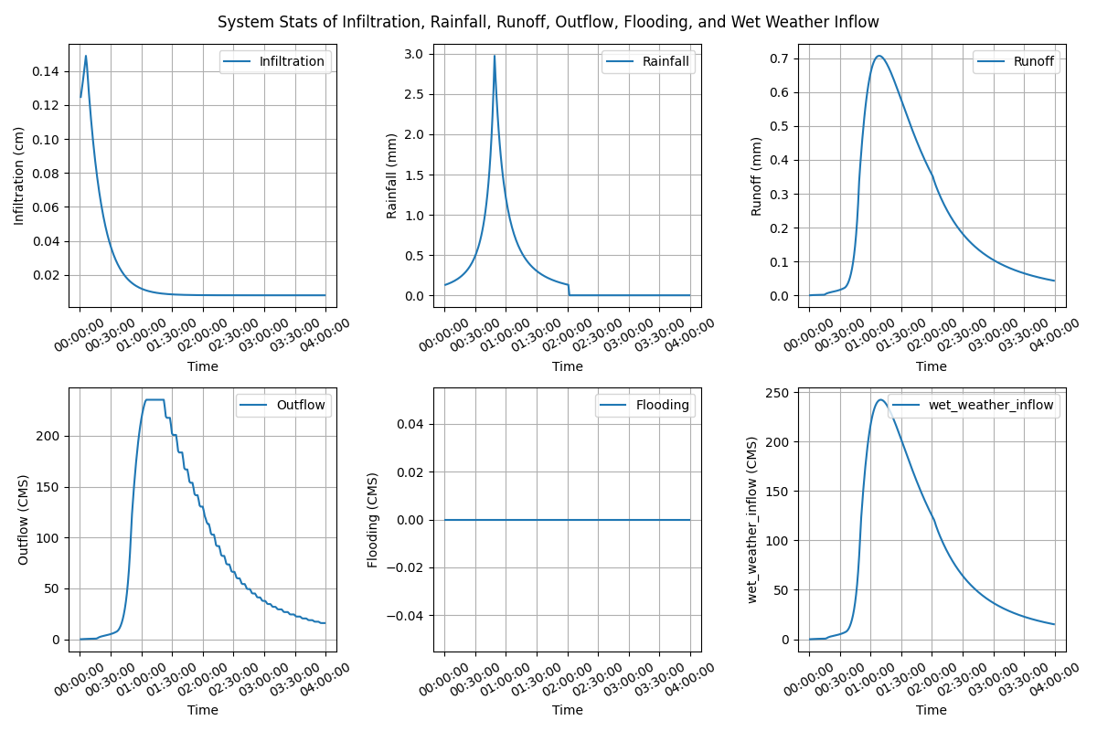
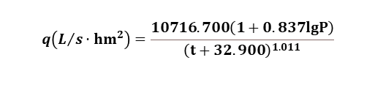
Lijia Mountain Park, Nanjing, China
Subcatchments: 30
Area: 33.73ha
Rainfall- Chicago design storm IDF
Return period: 5 year (2 hour)
Total volume: 75.59mm
IDF formula:
$$q\left(L/s·{hm}^{2}\right)=\frac{10716.700\left(1+0.837lgP\right)}{{\left(t+32.900\right)}^{1.011}}$$

Slide 5
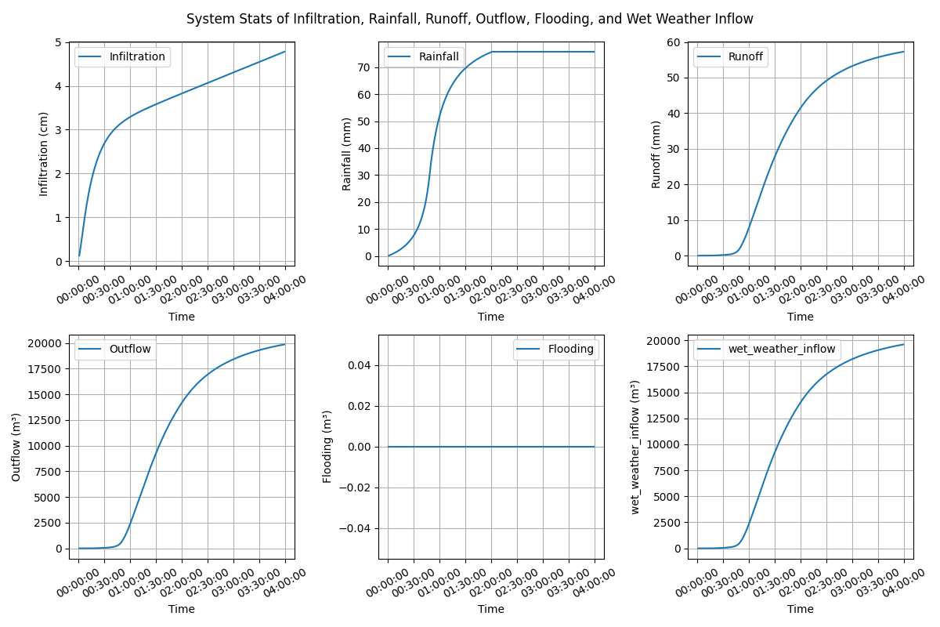
Lijia Mountain Park, Nanjing, China
Subcatchments: 30
Area: 33.73ha
Rainfall- Chicago design storm IDF
Return period: 5 year (2 hour)
Total volume: 75.59mm

Slide 6
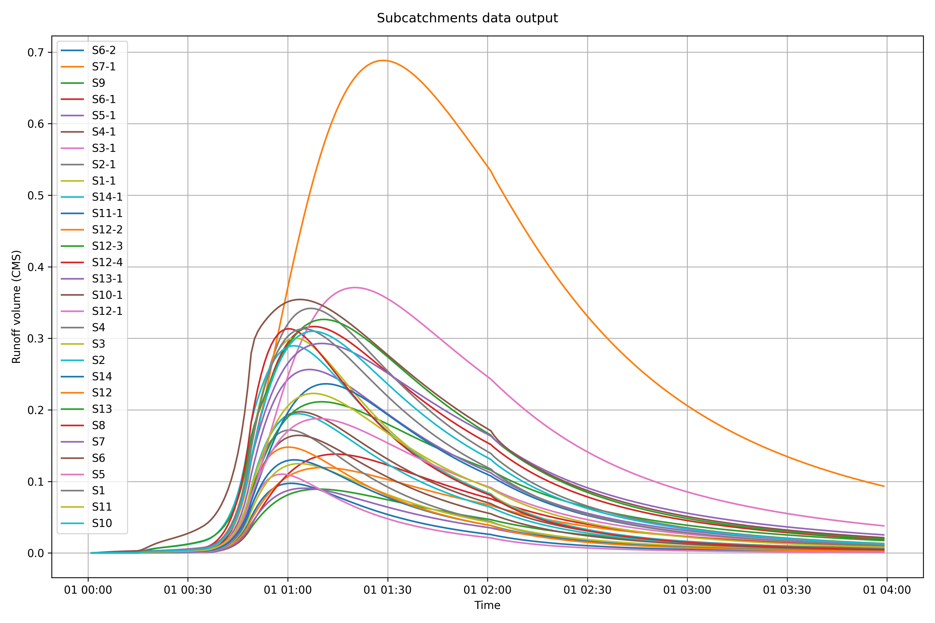
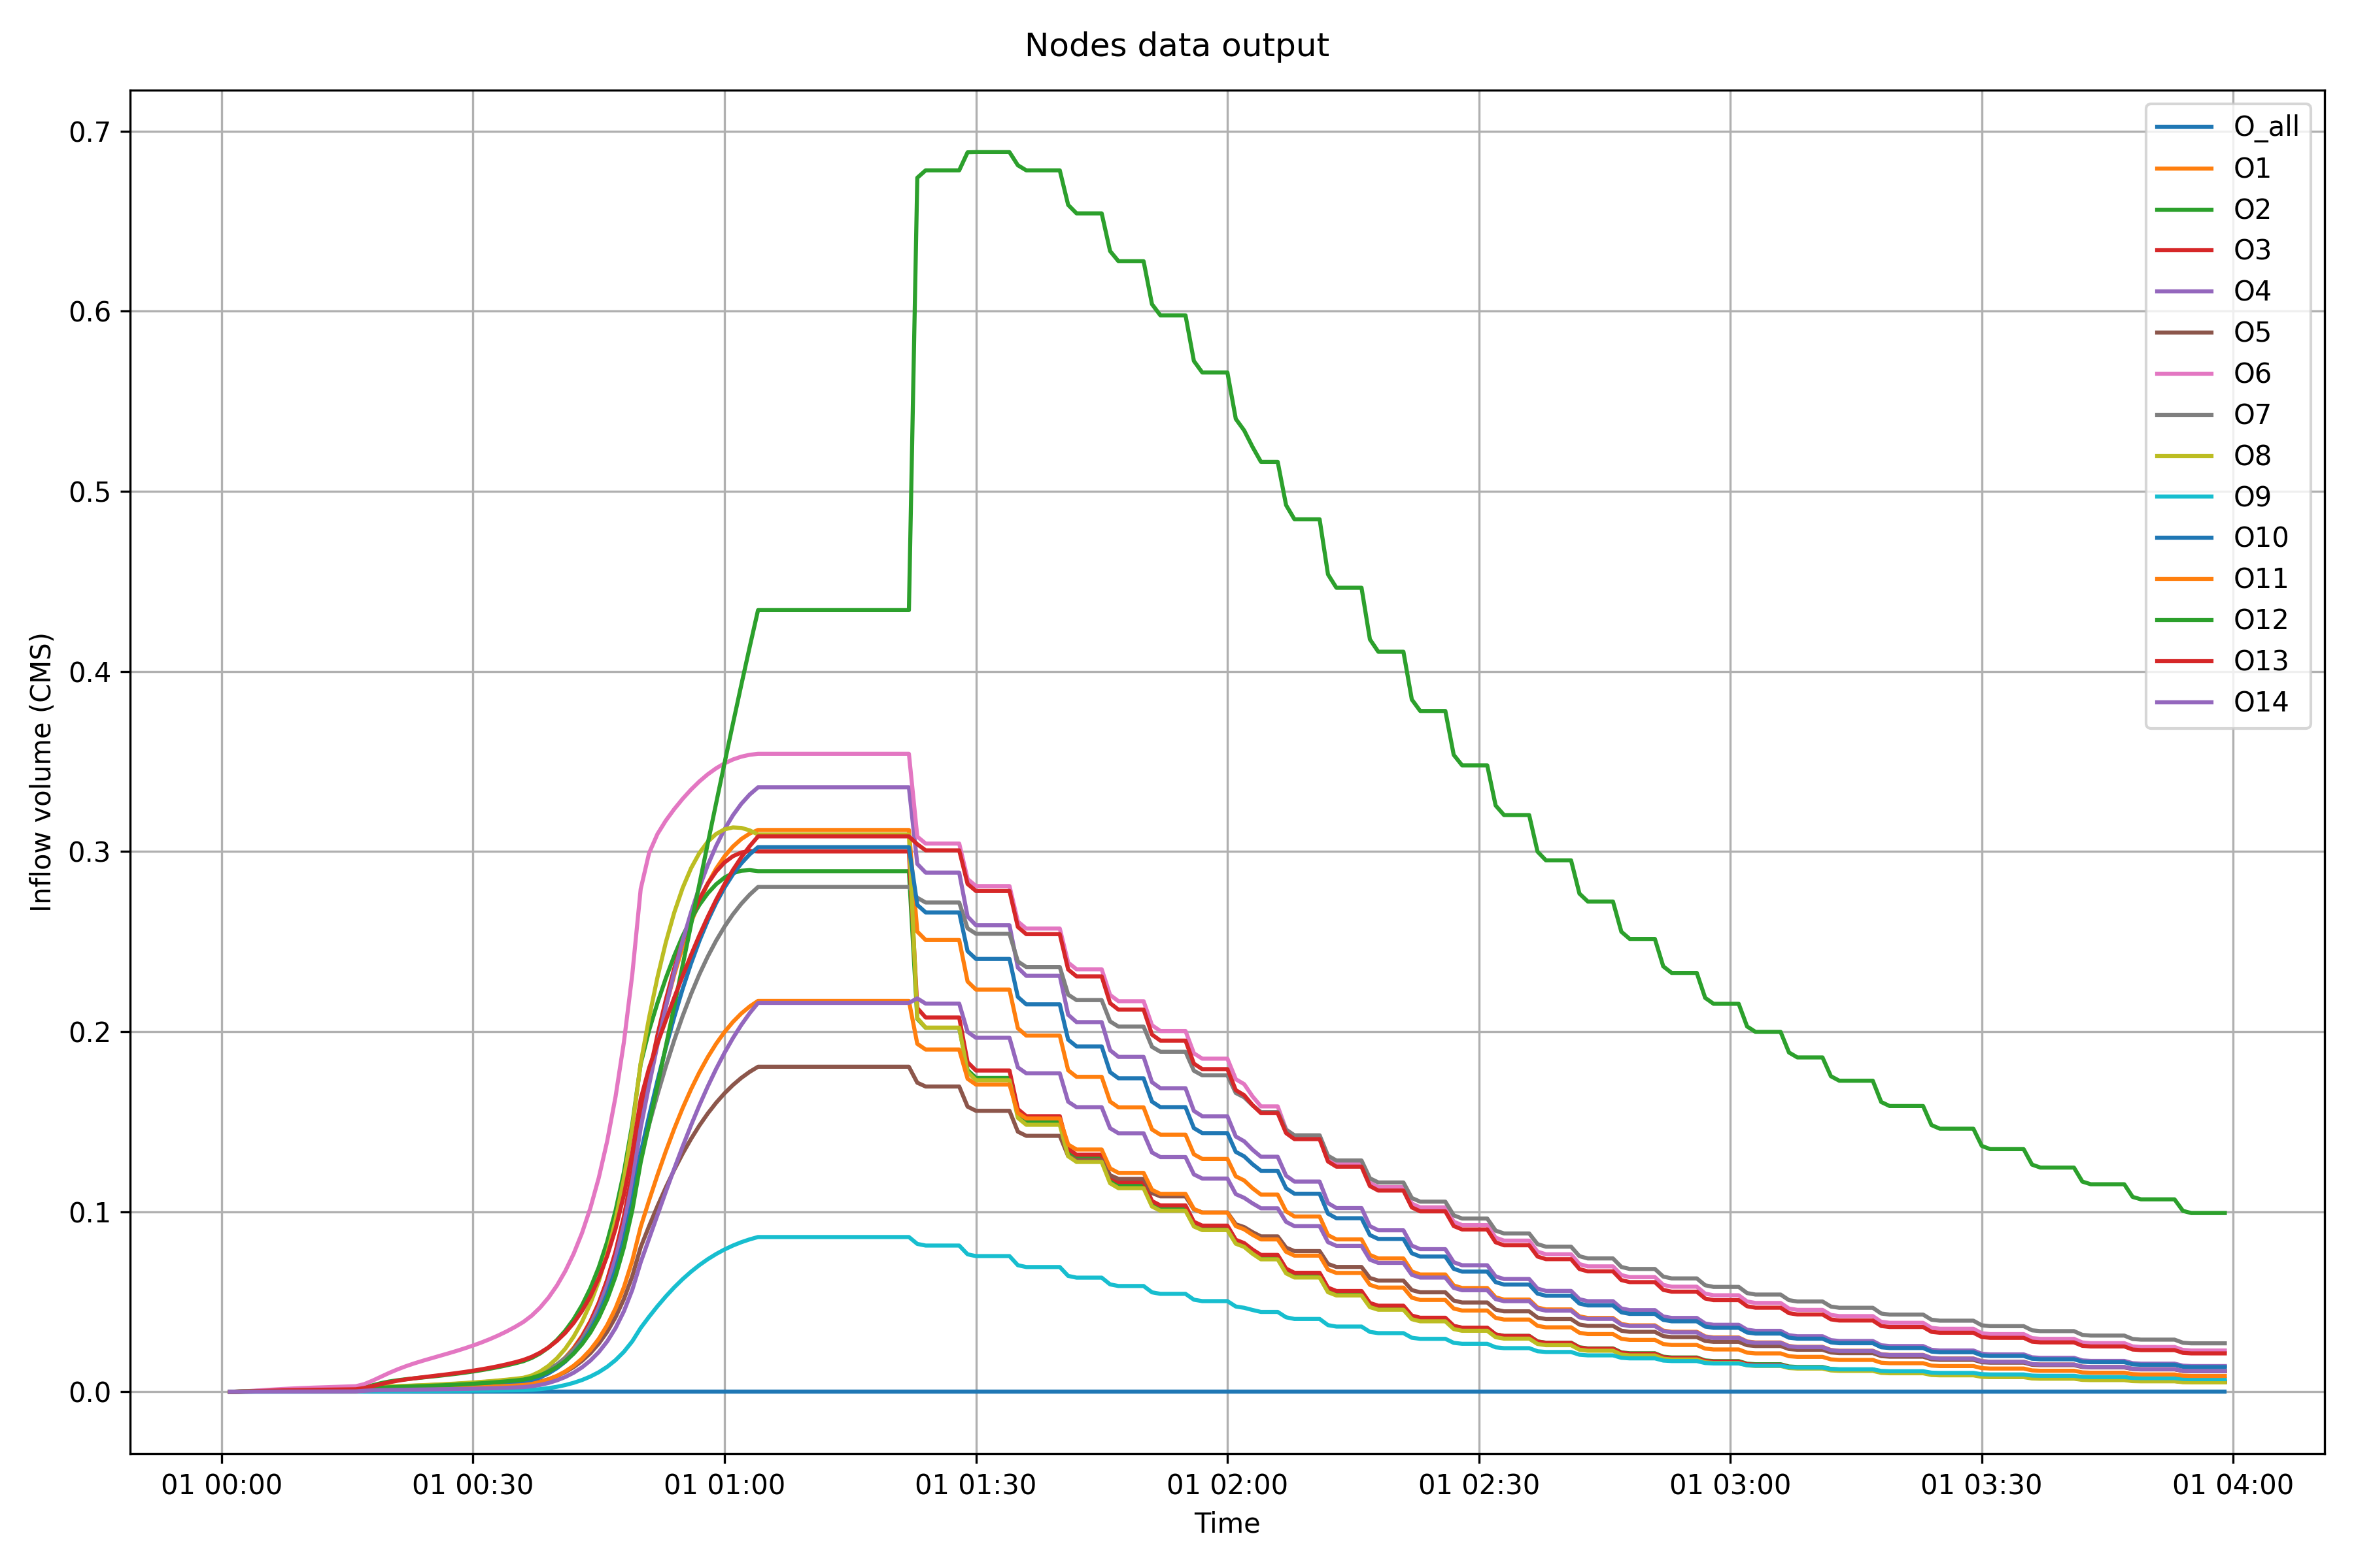

Slide 7
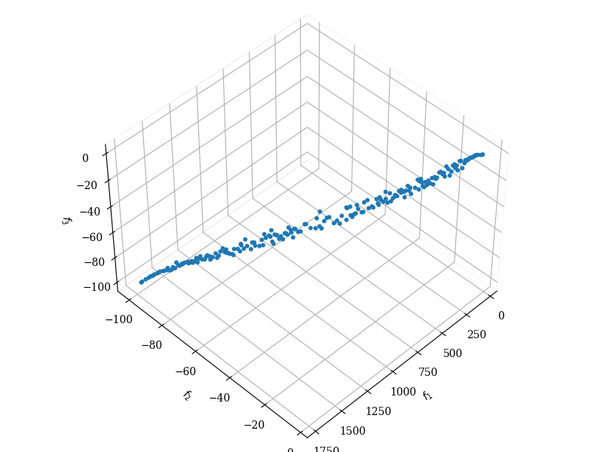
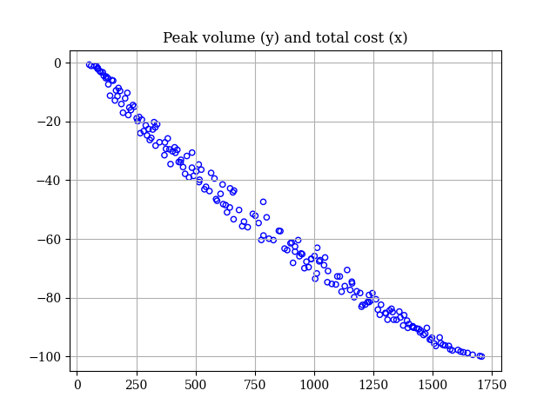
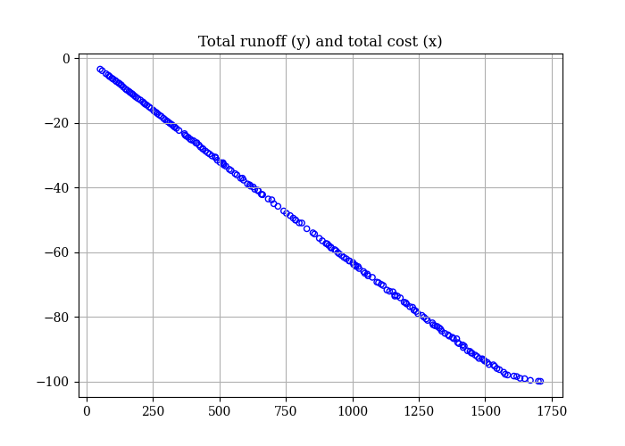
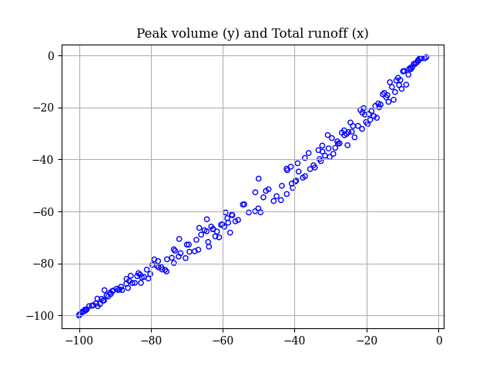

Slide 8
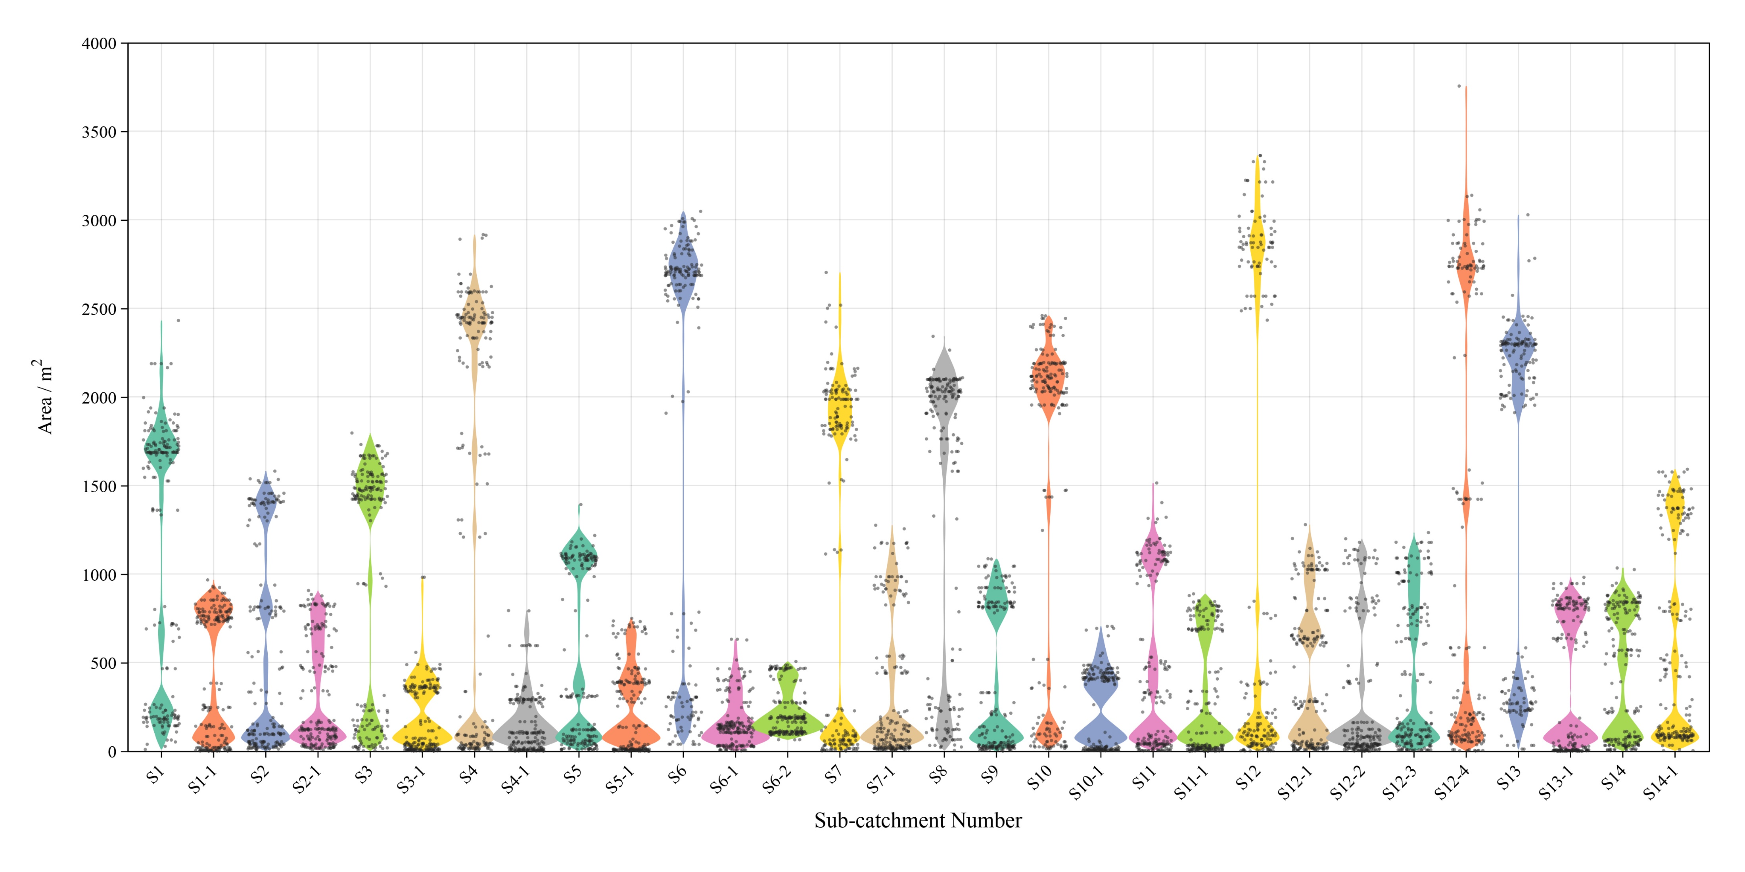

Slide 9
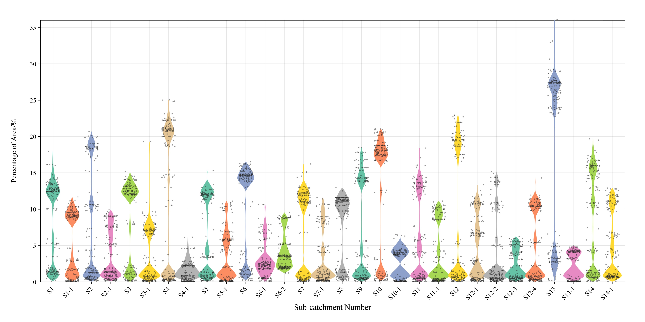

Slide 10
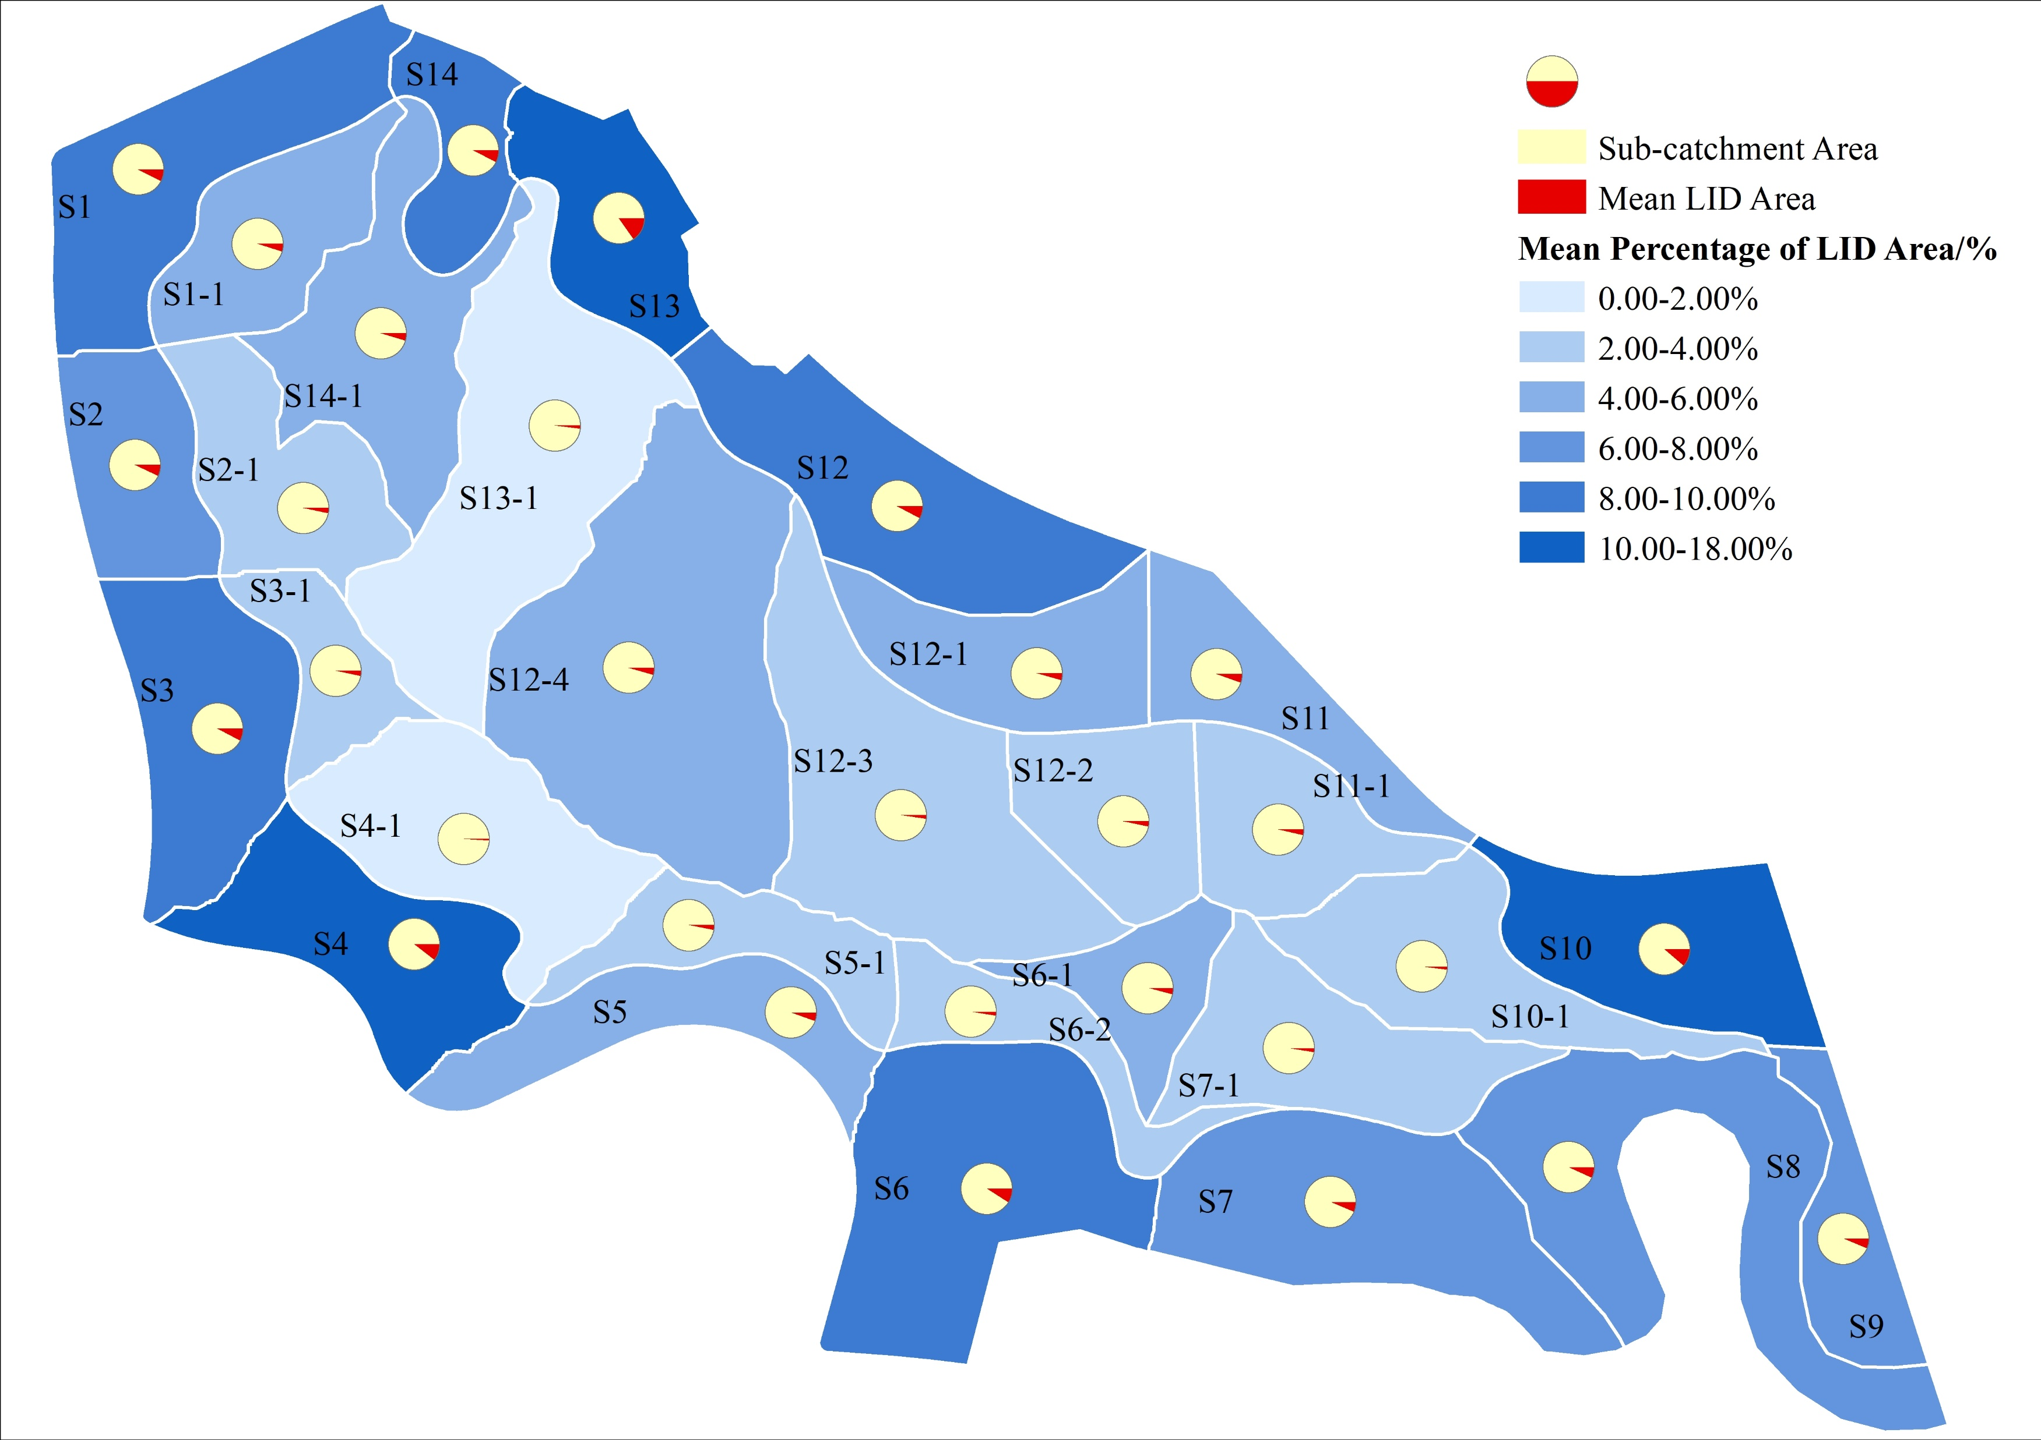

Slide 11

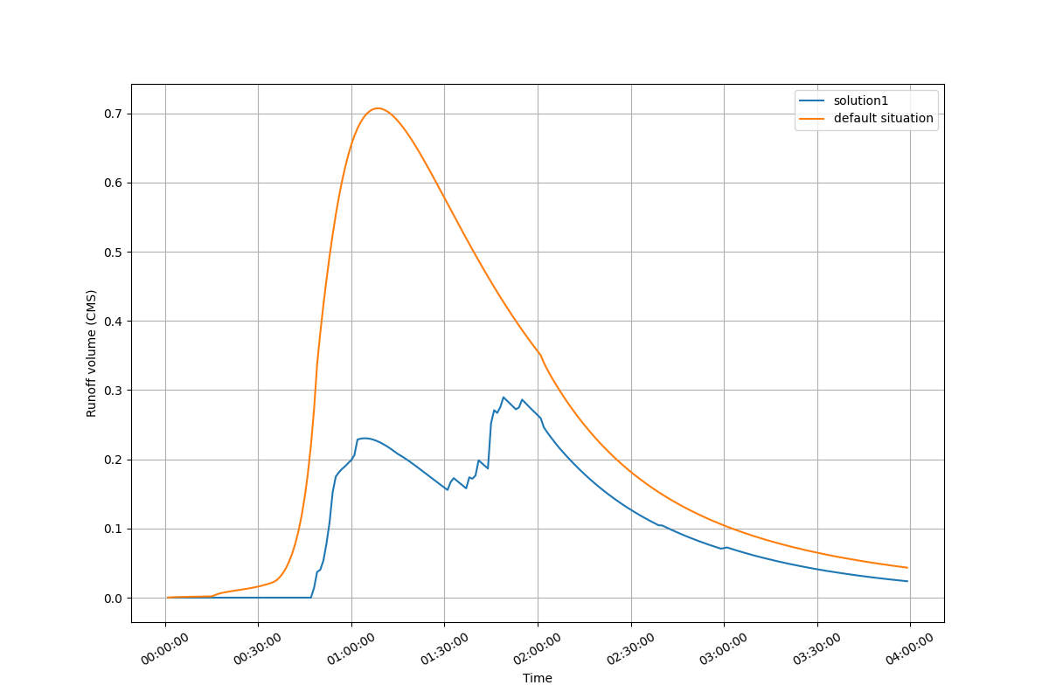
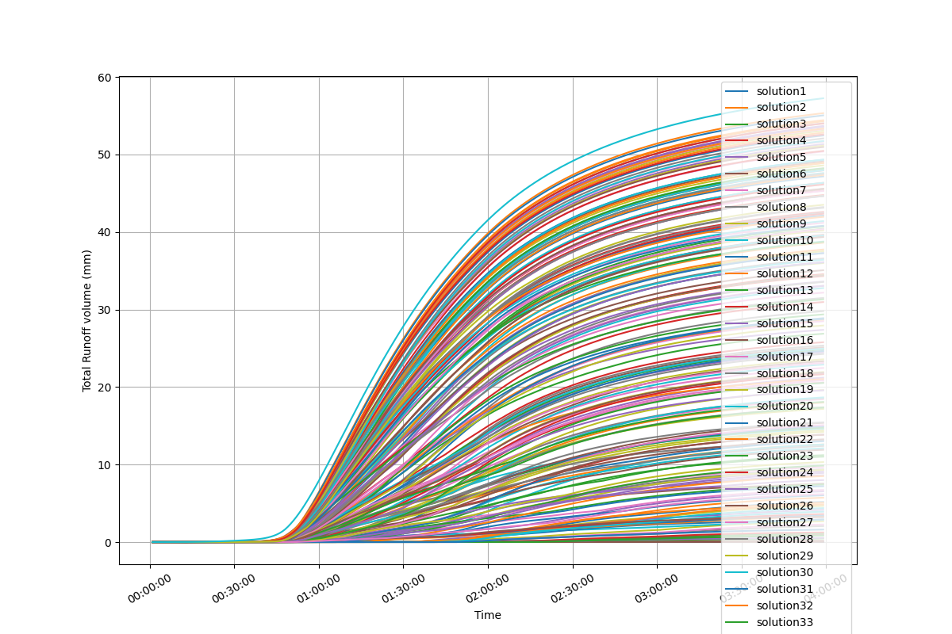
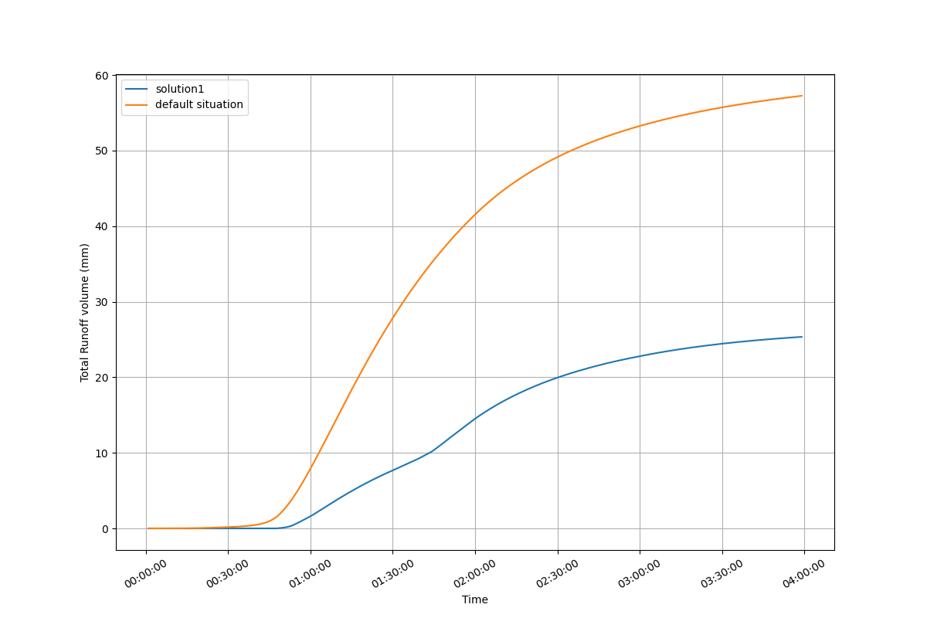
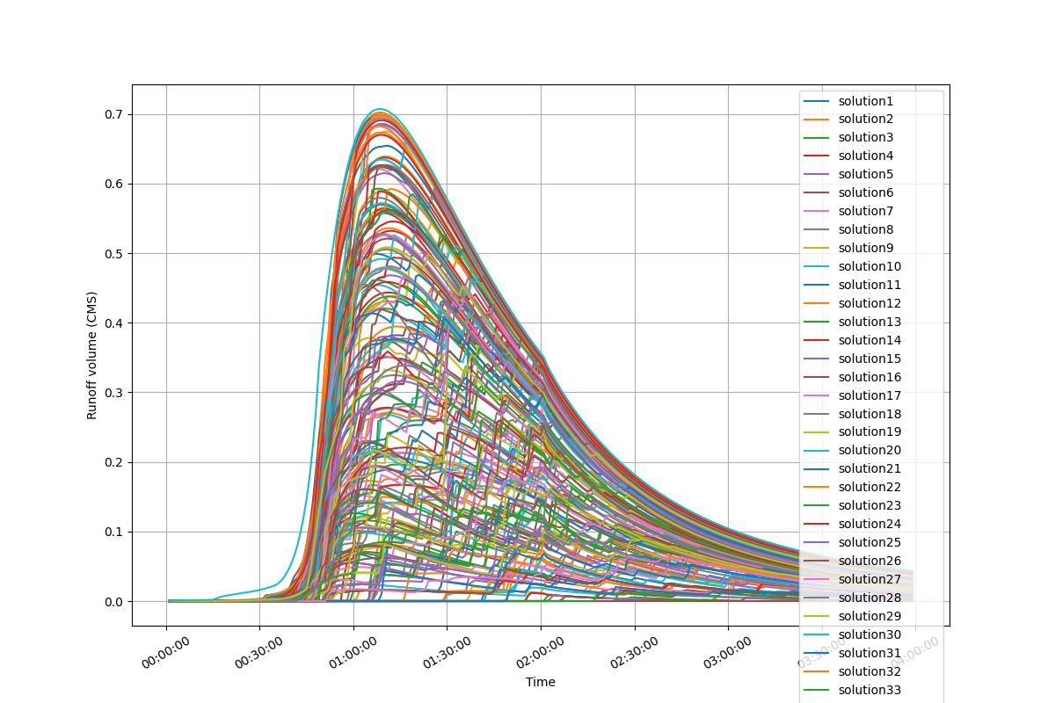
Solution: 17
Balance solution
Cost: 852.0068(10k RMB）
TR reduction: 54.01%
PR reduction 57.23%
BRCs area: 21300.17m²

Slide 18
Scenario 02

Slide 19
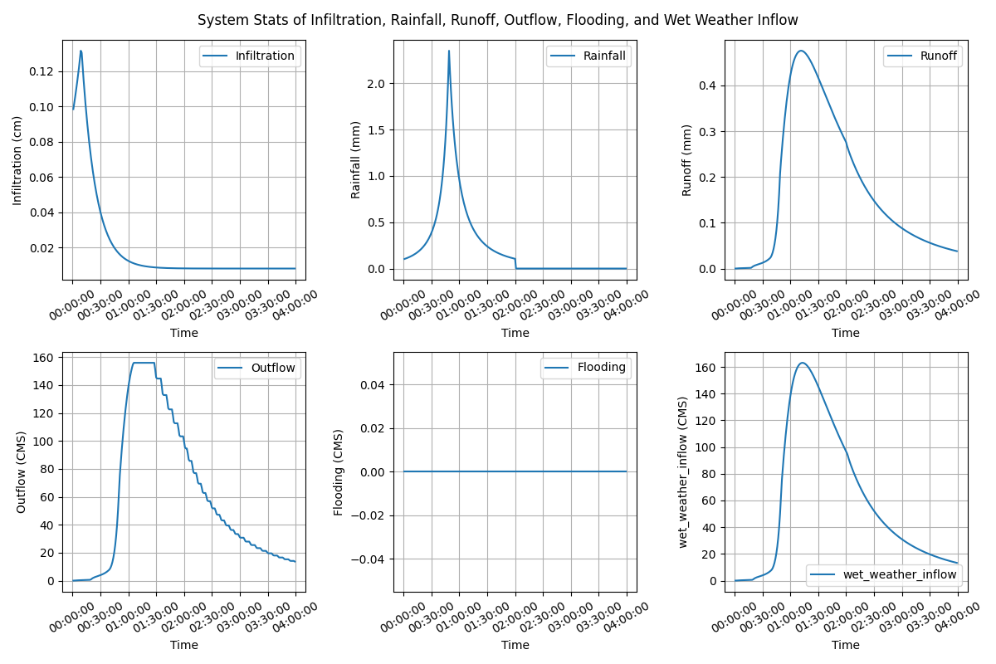
Lijia Mountain Park, Nanjing, China
Subcatchments: 30
Area: 33.73ha
Rainfall- Chicago design storm IDF
Return period: 2 year (2 hour)
Total volume: 59.71mm

Slide 20
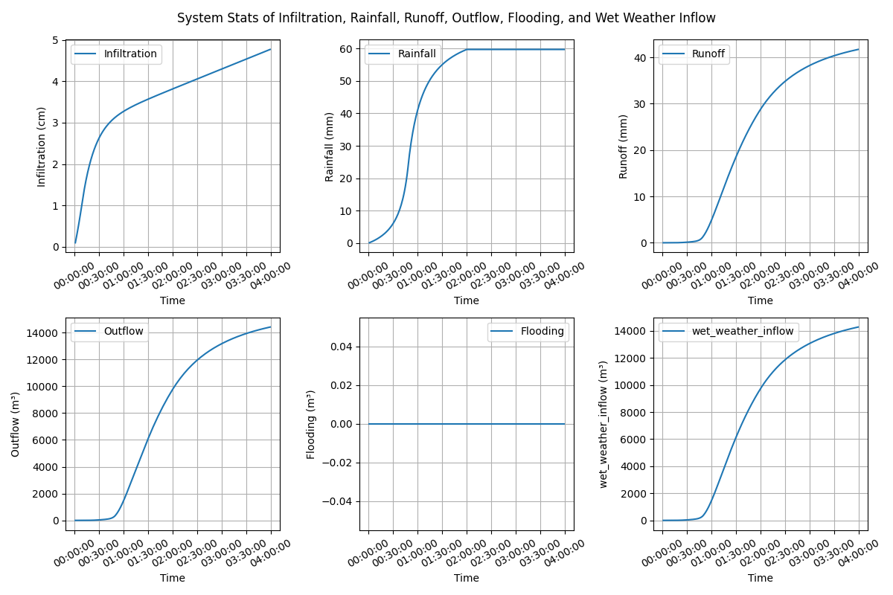
Lijia Mountain Park, Nanjing, China
Subcatchments: 30
Area: 33.73ha
Rainfall- Chicago design storm IDF
Return period: 2 year (2 hour)
Total volume: 59.71mm

Slide 21
